Slide 1
Week 4
Peer Assisted Learning

Slide 2
Today’s Session
C!
So, today in PAL is an opportunity to just do your C coursework and talk about questions you have with us and we can attempt to help as best as we can ☺
First, we’ll go a bit through pointers.
We can’t walk through specific questions, but we can highlight some resources before you start working on it.

Slide 3
C & Pointers (aka programmer’s biggest enemy)
A pointer is just a variable.
Its value is the address of another variable (the memory address of where that value is stored).
The general form in C for a pointer variable is:
type *variableName;
int *number;
char *letter;
(Note that type* variableName is also valid, and it may be more clear to write it like this - do whatever makes more sense for you)

Slide 4
How do we use them?
Few Key Operations:
Defining the pointer variable (shown on the page previously).
Assigning the address of a variable to a pointer.
Accessing the value at the address available in the pointer variable.

Slide 5
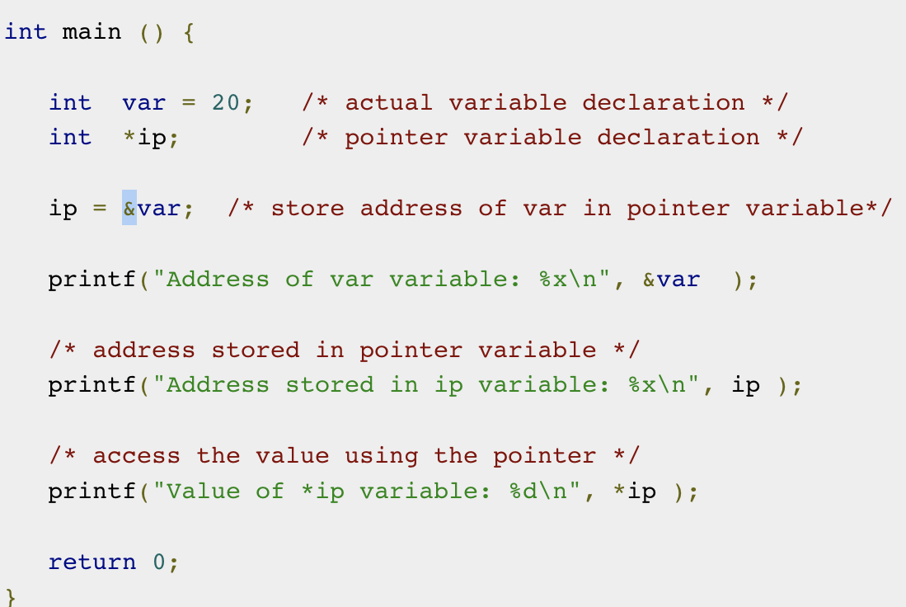
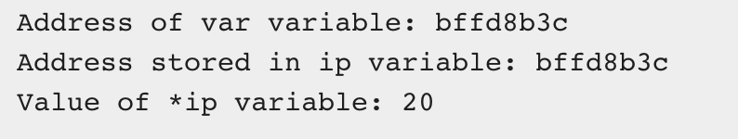
Code Example
We declare an integer variable, and then an integer pointer variable.
We get the address of the integer variable through the & sign.
‘&’ Gives the address of the variable it is used next to.
’*’ will get the value of whatever the pointer is pointing at.

Slide 6
Null Pointers
A Null pointer is a pointer that does not point to any memory location.
It’s just a pointer that is assigned NULL.
Why do we use it?
Used to perform error handling with pointers before dereferencing them. E.g., they can represent conditions like the end of a list of unknown length.

Slide 7
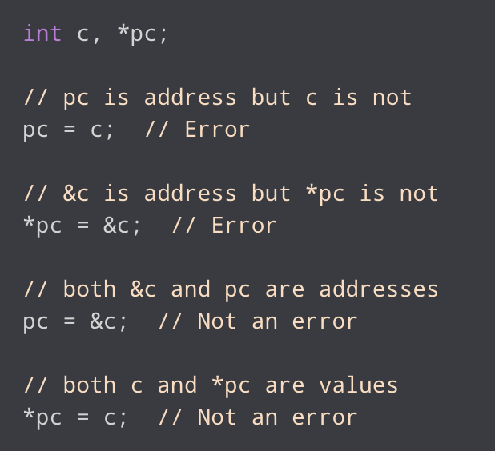
Common Mistakes with Pointers

Slide 8
Pointers & Functions
We can also have pointers to functions. Similarly, we are just storing the address of a function.
Function Pointer Syntax:
void (*foo) (int);
Foo is a pointer to a function. This function takes one argument, an integer, and returns void.
Things get more confusing when we start to put stars everywhere:
void *(*foo) (int *);
How do we read this? Perhaps best to read inside-out.

Slide 9
Function Pointers
void *(*foo) (int *);
foo is a pointer to a function that returns a void * (that is, a void pointer) and takes in an integer pointer as a parameter.
So foo is just a pointer to a function that:
Returns a void pointer.
Takes in an integer pointer.
(Note: A void pointer is not the same as a null pointer. Null is a ‘value’ that the pointer is pointing to, while void is a pointer type – the pointer points to a value that does not have a specific type.)

Slide 10
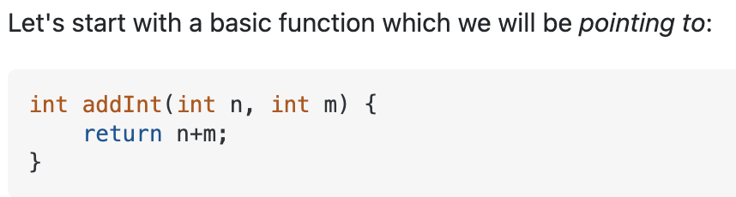
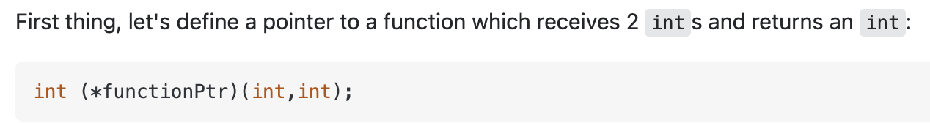
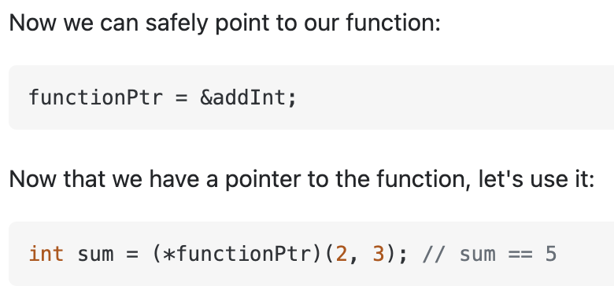
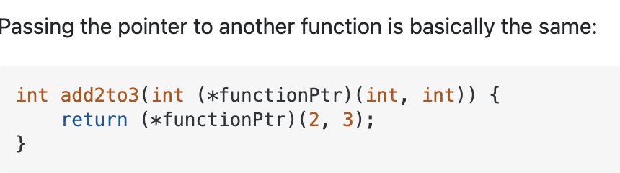
Function Pointers – (Stack Overflow) Example

Slide 11
Coursework ☺
Rest of the time on coursework.
Feel free to ask questions about your code and we can try to look but it has been quite a while since we have done C, but always happy to try to help and listen anyway.

Slide 12
Recourses
Good Overview on Pointers:
https://www.tutorialspoint.com/cprogramming/c_pointers.htm
Code Academy 4 Hour Course on Pointers:
https://www.youtube.com/watch?v=zuegQmMdy8M
Popular Stack Overflow Discussion on Function Pointers:
https://stackoverflow.com/questions/840501/how-do-function-pointers-in-c-work

